Slide 1

CSE 2006 - Programming in Java Course Type: LP Credits: 3

Slide 2
Unit-2 Java Object-oriented Programming
Java OOP (Basics)
Java Class and Objects, Java Methods, Java Constructor, Java Strings, Java Access Modifiers, Java this keyword, Java final keyword, Java Recursion, Java instance of Operator, Java Single Class and Anonymous Class, Java enum Class
Java OOP (Inheritance & Polymorphism)
Java Inheritance, Java Method Overriding, Java super Keyword, Abstract Class & Method, Java Interfaces, Java Polymorphism (overloading & overriding), Java Encapsulation
Java OOP (Other types of classes)
Nested & Inner Class, Java Static Class, Java Anonymous Class, Java Singleton, Java enum Class, Java enum Constructor, Java enum String, Java Reflection.

Slide 3
Nested & Inner Class
Java inner class or nested class is a class that is declared inside the class or interface.
We use inner classes to logically group classes and interfaces in one place to be more readable and maintainable.
Additionally, it can access all the members of the outer class, including private data members and methods.
Syntax of Inner class
class Java_Outer_class{
//code
class Java_Inner_class{
//code
}
}

Slide 4
Nested & Inner Class
Advantage of Java inner classes
There are three advantages of inner classes in Java. They are as follows:
Nested classes represent a particular type of relationship that is it can access all the members (data members and methods) of the outer class, including private.
Nested classes are used to develop more readable and maintainable code because it logically group classes and interfaces in one place only.
Code Optimization: It requires less code to write.

Slide 5
Nested & Inner Class
Need of Java Inner class
Sometimes users need to program a class in such a way so that no other class can access it. Therefore, it would be better if you include it within other classes.
If all the class objects are a part of the outer object then it is easier to nest that class inside the outer class. That way all the outer class can access all the objects of the inner class.

Slide 6
Nested & Inner Class
Difference between nested class and inner class in Java
An inner class is a part of a nested class. Non-static nested classes are known as inner classes.
Types of Nested classes
There are two types of nested classes non-static and static nested classes. The non-static nested classes are also known as inner classes.
Non-static nested class (inner class)
Member inner class
Anonymous inner class
Local inner class
Static nested class

Slide 7
Nested & Inner Class
Type | Description
Member Inner Class | A class created within class and outside method.
Anonymous Inner Class | A class created for implementing an interface or extending class. The java compiler decides its name.
Local Inner Class | A class was created within the method.
Static Nested Class | A static class was created within the class.
Nested Interface | An interface created within class or interface.

Slide 8
Nested & Inner Class
Java Member Inner class
A non-static class that is created inside a class but outside a method is called member inner class. It is also known as a regular inner class. It can be declared with access modifiers like public, default, private, and protected.
Syntax:
class Outer{
//code
class Inner{
//code
}
}

Slide 9
Nested & Inner Class
Java Member Inner Class Example
In this example, we are creating a msg() method in the member inner class that is accessing the private data member of the outer class.
TestMemberOuter1.java
class TestMemberOuter1{
private int data=30;
class Inner{
void msg(){System.out.println("data is "+data);}
}
public static void main(String args[]){
TestMemberOuter1 obj=new TestMemberOuter1();
TestMemberOuter1.Inner in=obj.new Inner();
in.msg();
}
}
Output:
data is 30

Slide 10
Java Anonymous inner class
Java anonymous inner class is an inner class without a name and for which only a single object is created.
An anonymous inner class can be useful when making an instance of an object with certain "extras" such as overloading methods of a class or interface, without having to actually subclass a class.
In simple words, a class that has no name is known as an anonymous inner class in Java. It should be used if you have to override a method of class or interface.
Java Anonymous inner class can be created in two ways:
Class (may be abstract or concrete).
Interface

Slide 11
Java Anonymous inner class
Java anonymous inner class example using class
TestAnonymousInner.java
abstract class Person{
abstract void eat();
}
class TestAnonymousInner{
public static void main(String args[]){
Person p=new Person(){
void eat(){System.out.println("nice fruits");}
};
p.eat();
}
}
Output:
nice fruits

Slide 12
Java Anonymous inner class
Java anonymous inner class example using interface
interface Eatable{
void eat();
}
class TestAnnonymousInner1{
public static void main(String args[]){
Eatable e=new Eatable(){
public void eat(){System.out.println("nice fruits");}
};
e.eat();
}
}
Output:
nice fruits

Slide 13
Java Anonymous inner class
Java Local inner class
A class i.e., created inside a method, is called local inner class in java. Local Inner Classes are the inner classes that are defined inside a block. Generally, this block is a method body. Sometimes this block can be a for loop, or an if clause.
Local Inner classes are not a member of any enclosing classes. They belong to the block they are defined within, due to which local inner classes cannot have any access modifiers associated with them. However, they can be marked as final or abstract. These classes have access to the fields of the class enclosing it.
If you want to invoke the methods of the local inner class, you must instantiate this class inside the method.

Slide 14
Java Anonymous inner class
Java local inner class example
LocalInner1.java
public class localInner1{
private int data=30;//instance variable
void display(){
class Local{
void msg(){System.out.println(data);}
}
Local l=new Local();
l.msg();
}
public static void main(String args[]){
localInner1 obj=new localInner1();
obj.display();
}
}
Output:
30

Slide 15
Java static nested class
A static class is a class that is created inside a class, is called a static nested class in Java. It cannot access non-static data members and methods. It can be accessed by outer class name.
It can access static data members of the outer class, including private.
The static nested class cannot access non-static (instance) data members.
Java static nested class example with instance method
TestOuter1.java
class TestOuter1{
static int data=30;
static class Inner{
void msg(){System.out.println("data is "+data);}
}
public static void main(String args[]){
TestOuter1.Inner obj=new TestOuter1.Inner();
obj.msg();
}
}
In this example, you need to create the instance of static nested class because it has instance method msg(). But you don't need to create the object of the Outer class because the nested class is static and static properties, methods, or classes can be accessed without an object.
Output:
data is 30

Slide 16
Java Singleton class
In Java, Singleton is a design pattern that ensures that a class can only have one object.
To create a singleton class, a class must implement the following properties:
Create a private constructor of the class to restrict object creation outside of the class.
Create a private attribute of the class type that refers to the single object.
Create a public static method that allows us to create and access the object we created.
Inside the method, we will create a condition that restricts us from creating more than one object.

Slide 17
Java Singleton class
Example: Java Singleton Class Syntax
class SingletonExample {
// private field that refers to the object
private static SingletonExample singleObject;
private SingletonExample()
{ // constructor of the SingletonExample class }
public static SingletonExample getInstance()
{ // write code that allows us to create only one object
// access the object as per our need
} }
In the above example,
private static SingletonExample singleObject - a reference to the object of the class.
private SingletonExample() - a private constructor that restricts creating objects outside of the class.
public static SingletonExample getInstance() - this method returns the reference to the only object of the class. Since the method static, it can be accessed using the class name.
https://www.programiz.com/java-programming/singletonjava

Slide 18
Java Singleton class
Use of Singleton in Java
Singletons can be used while working with databases.
They can be used to create a connection pool to access the database while reusing the same connection for all the clients.

Slide 19
Java Singleton class
class Database {
private static Database dbObject;
private Database() {
}
public static Database getInstance() {
// create object if it's not already created
if(dbObject == null) {
dbObject = new Database();
}
// returns the singleton object
return dbObject;
}
public void getConnection() {
System.out.println("You are now connected to the database.");
}
}
class Main {
public static void main(String[] args) {
Database db1;
// refers to the only object of Database
db1= Database.getInstance();
db1.getConnection();
}
}
Output:
You are now connected to the database.

Slide 20
Java Singleton class
In our above example,
We have created a singleton class Database.
The dbObject is a class type field. This will refer to the object of the class Database.
The private constructor Database() prevents object creation outside of the class.
The static class type method getInstance() returns the instance of the class to the outside world.
In the Main class, we have class type variable db1. We are calling getInstance() using db1 to get the only object of the Database.
The method getConnection() can only be accessed using the object of the Database.
Since the Database can have only one object, all the clients can access the database through a single connection.

Slide 21
Java enum Class
In Java, an enum (short for enumeration) is a type that has a fixed set of constant values. We use the enum keyword to declare enums.
For example,
enum Size
{
SMALL, MEDIUM, LARGE, EXTRALARGE
}
Here, we have created an enum named Size. It contains fixed values SMALL, MEDIUM, LARGE, and EXTRALARGE.
These values inside the braces are called enum constants (values).
Note: The enum constants are usually represented in uppercase.
More: https://www.programiz.com/java-programming/enums

Slide 22
Java enum Class
Example 1: Java Enum
enum Size {
SMALL, MEDIUM, LARGE, EXTRALARGE
}
class en {
public static void main(String[] args) {
System.out.println(Size.SMALL);
System.out.println(Size.MEDIUM);
}
}
Output:
SMALL
MEDIUM

Slide 23
Java enum Constructor
In Java, an enum class may include a constructor like a regular class. These enum constructors are either
private - accessible within the class or
package-private - accessible within the package

Slide 24
Java enum Constructor
Example: enum Constructor
enum Size { // enum constants calling the enum constructors
SMALL("The size is small."),
MEDIUM("The size is medium."),
LARGE("The size is large."),
EXTRALARGE("The size is extra large.");
private final String pizzaSize;
// private enum constructor
private Size(String pizzaSize) {
this.pizzaSize = pizzaSize;
}
public String getSize() {
return pizzaSize;
}
}
class Main {
public static void main(String[] args) {
Size size = Size.SMALL;
System.out.println(size.getSize());
}
}
Output:
The size is small.

Slide 25
Java enum Constructor
In the above example, we have created an enum Size. It includes a private enum constructor. The constructor takes a string value as a parameter and assigns value to the variable pizzaSize.
Since the constructor is private, we cannot access it from outside the class. However, we can use enum constants to call the constructor.
In the Main class, we assigned SMALL to an enum variable size. The constant SMALL then calls the constructor Size with string as an argument.
Finally, we called getSize() using size.

Slide 26
Java enum String
Before you learn about enum strings, make sure to know about Java enum.
In Java, we can get the string representation of enum constants using the toString() method or the name() method. For example,
enum Size {
SMALL, MEDIUM, LARGE, EXTRALARGE
}
class Main {
public static void main(String[] args) {
System.out.println("string value of SMALL is " + Size.SMALL.toString());
System.out.println("string value of MEDIUM is " + Size.MEDIUM.name());
}
}
Output:
string value of SMALL is SMALL
string value of MEDIUM is MEDIUM

Slide 27
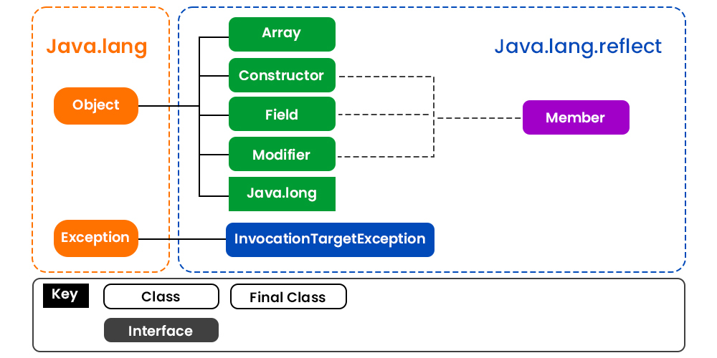
Java Reflection
Reflection is an API that is used to examine or modify the behavior of methods, classes, and interfaces at runtime.
The required classes for reflection are provided under java.lang.reflect package which is essential in order to understand reflection. So we are illustrating the package with visual aids to have a better understanding as follows:

Slide 28
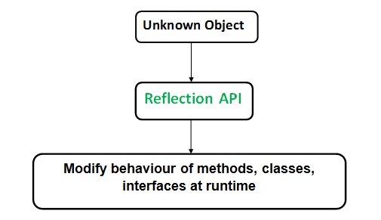
Java Reflection
Reflection gives us information about the class to which an object belongs and also the methods of that class that can be executed by using the object.
Through reflection, we can invoke methods at runtime irrespective of the access specifier used with them.

Slide 29
Java Reflection
Reflection can be used to get information about class, constructors, and methods as depicted below in tabular format as shown:
Class | The getClass() method is used to get the name of the class to which an object belongs.
Constructors | The getConstructors() method is used to get the public constructors of the class to which an object belongs.
Methods | The getMethods() method is used to get the public methods of the class to which an object belongs.
https://www.geeksforgeeks.org/reflection-in-java/

Slide 30
Java Reflection
In Java, reflection allows us to inspect and manipulate classes, interfaces, constructors, methods, and fields at run time.
There is a class in Java named Class that keeps all the information about objects and classes at runtime. The object of Class can be used to perform reflection.

Slide 31
Java Reflection
Reflection of Java Classes
In order to reflect a Java class, we first need to create an object of Class.
And, using the object we can call various methods to get information about methods, fields, and constructors present in a class.
There exists three ways to create objects of Class:
1. Using forName() method
class Dog {...} // create object of Class to reflect the Dog
class Class a = Class.forName("Dog");
Here, the forName() method takes the name of the class to be reflected as its argument.
2. Using getClass() method
// create an object of Dog class
Dog d1 = new Dog(); // create an object of Class // to reflect Dog
Class b = d1.getClass();
Here, we are using the object of the Dog class to create an object of Class.
3. Using .class extension
// create an object of Class // to reflect the Dog class
Class c = Dog.class;
Now that we know how we can create objects of the Class. We can use this object to get information about the corresponding class at runtime.

Slide 32
Java Reflection
Example: Java Class Reflection
import java.lang.Class;
import java.lang.reflect.*;
class Animal { }
// put this class in different Dog.java file
public class Dog extends Animal {
public void display() {
System.out.println("I am a dog.");
}
}
// put this in Main.java file

Slide 33
Java Reflection
Example: Java Class Reflection
// put this in Main.java file
class Main {
public static void main(String[] args) {
try { // create an object of Dog
Dog d1 = new Dog(); // create an object of Class using getClass()
Class obj = d1.getClass(); // get name of the class
String name = obj.getName();
System.out.println("Name: " + name);
// get the access modifier of the class
int modifier = obj.getModifiers();
// convert the access modifier to string
String mod = Modifier.toString(modifier);
System.out.println("Modifier: " + mod);
// get the superclass of Dog
Class superClass = obj.getSuperclass();
System.out.println("Superclass: " + superClass.getName());
}
catch (Exception e) {
e.printStackTrace();
} } }
Output:
Name: Dog
Modifier: public Superclass: Animal
https://www.programiz.com/java-programming/reflection

